Slide 1


Customer Churn Prediction

Slide 2




Our Team
Mohammad Al-Masre
Omar Alhaymoni
Eslam Al-Hajjaj
Laith Al-Saleh

Slide 3


Concepts
Introduction
01
Dataset Overview
02
Objective
03
Data understanding
04
Data preprocessing
05
Modelling
06
Results and visualization
07

Slide 4

Introduction
This presentation explores customer churn prediction using the Telco Customer Churn Dataset. We'll delve into the dataset, the prediction process, and actionable recommendations for preventing churn.
Understanding and predicting churn is vital for businesses to develop strategies to retain customers and minimize losses.

Slide 5
Objective
To understand the key factors influencing customer churn.
To preprocess the dataset and address data quality issues.
To implement machine learning algorithms for accurate churn prediction.
To evaluate model performance and provide actionable insights for decision-making.
Description of the Dataset

Slide 6
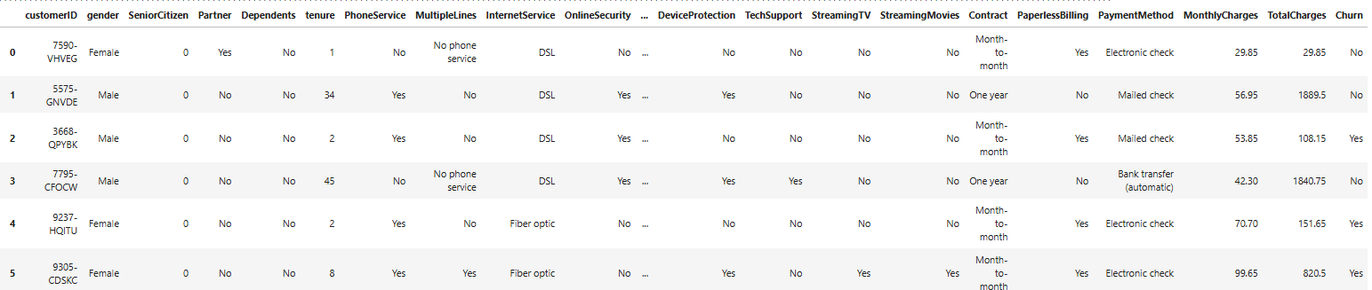
Data Understanding
Dataset contains 7043 rows (customers) and 21 columns (features).
We have (17) Categorical features , (4) Numerical features.

Slide 7
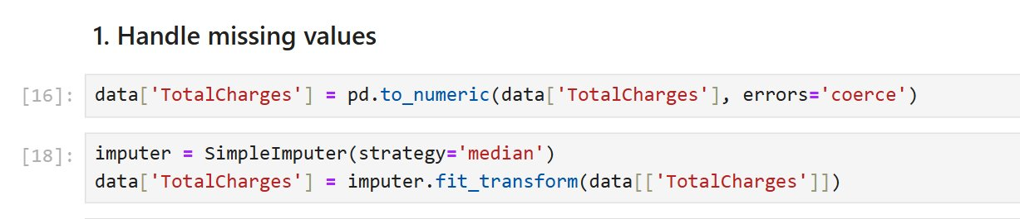
Data Preprocessing
Handle missing values, encode categorical features, normalize numerical features, and balance classes if necessary.
Convert the data to numaric values(int or float)
Replace invalid parsing with NaN
Handling with missing values by filling it by the median value

Slide 8
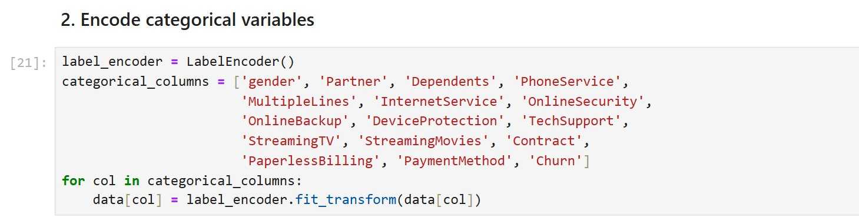
Replace all the categorical data to numerical data
The following snapshots will represents the difference

Slide 9
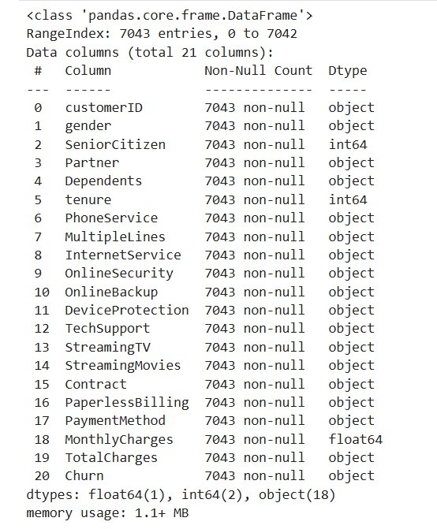
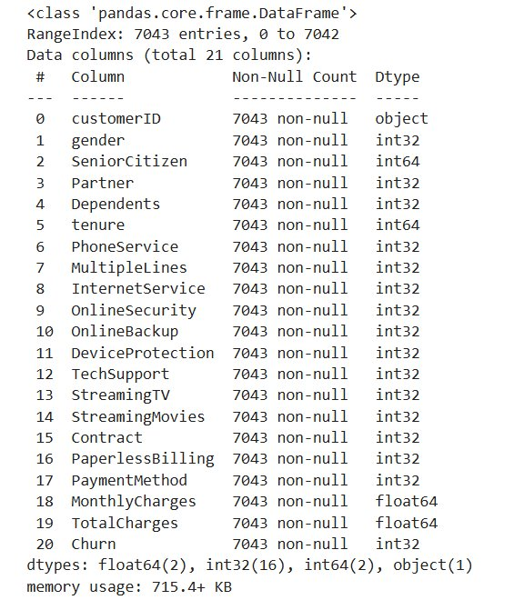
Before After

Slide 10
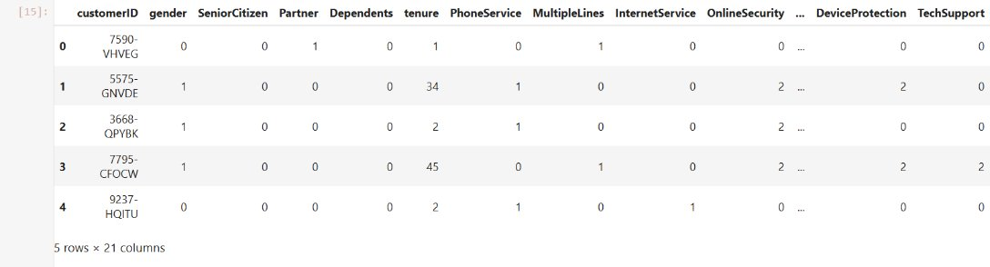
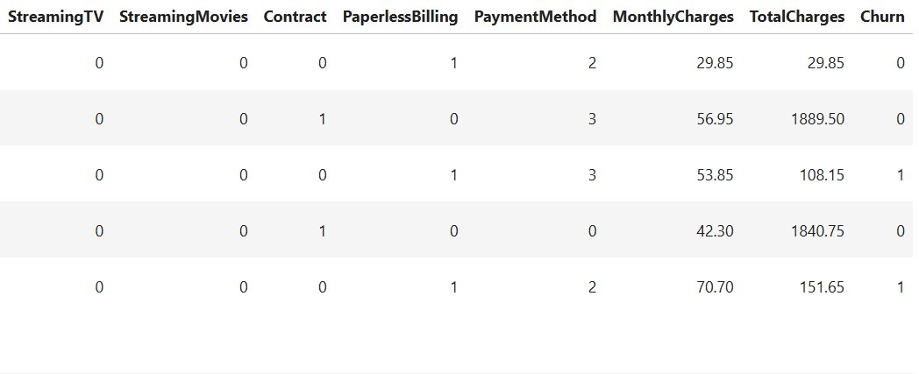
All the dataset features become numerical

Slide 11
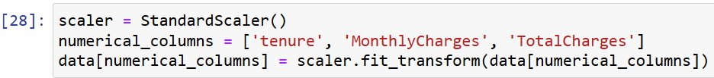
Scaling Numerical Variables
It Standardizes numerical features to have a mean of 0 and a standard deviation of 1
Purpose: Ensures that features are on the same scale, improving
the performance of models sensitive to feature magnitude.

Slide 12
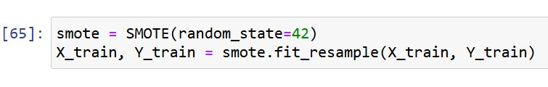
Handling Class Imbalance with SMOTE
it Applies Synthetic Minority Over-sampling Technique (SMOTE) to balance the classes
in the training dataset by generating synthetic samples for the minority class.
Purpose: Prevents the model from being biased toward the majority
class, improving prediction for the minority class.

Slide 13
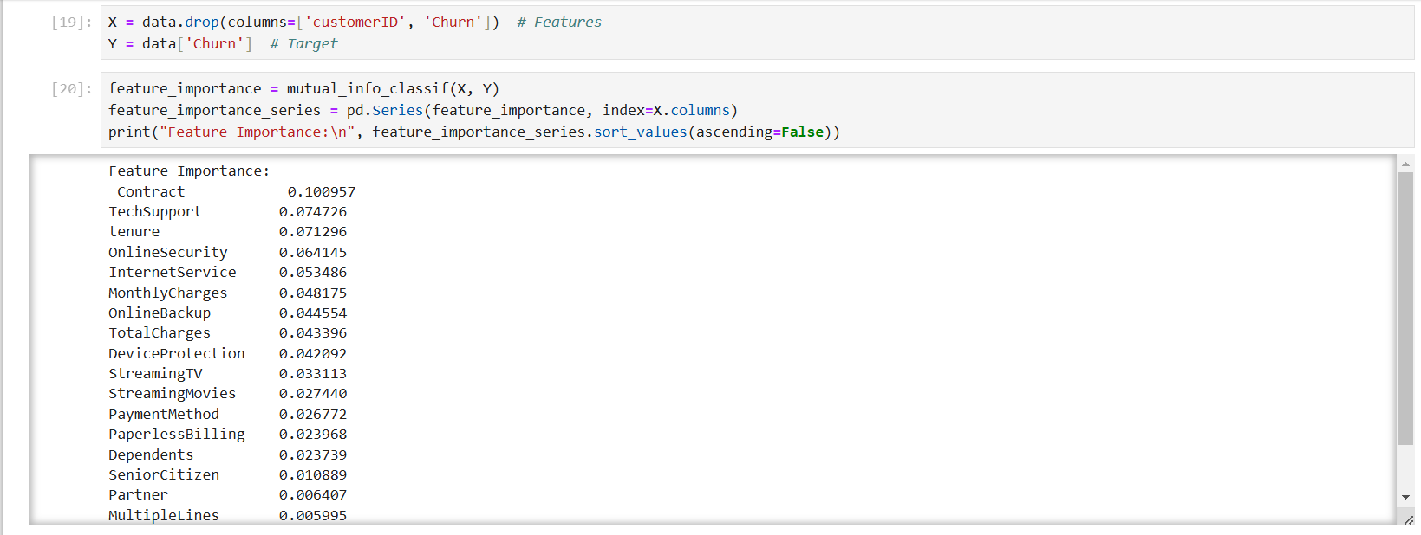
Feature Selection: Identifying Important Features​
​

Slide 14
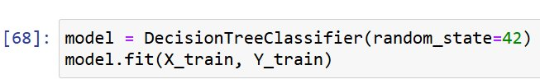
Modelling
Train-Test Split

Slide 15
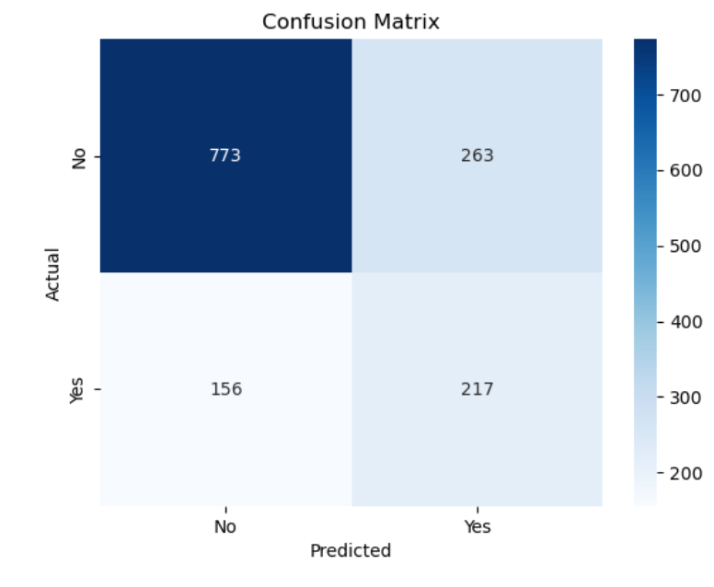
Model Evaluation
Accuracy: Proportion of correct predictions to total predictions = 0.70 – 0.74
Precision: Proportion of true positive predictions to all positive predictions
Measures how precise the model
=0.45 – 0.80
Recall (Sensitivity): Proportion of true positive predictions to all actual positives
Measures the ability to detect positives
=0.58 – 0.74
F1 Score: Harmonic mean of precision and recall
Useful for imbalanced datasets =0.51 – 0.75

